Slide 1

EDA On Repaying the Credit
By
Amrutha Padmakumar

Slide 2
Problem Statement
Gold Atlantis a credit-providing firm, observed a rise in the number of defaulters. Now the firm is only interested in those consumers who have a lower probability of becoming a defaulter.
The aim of this analysis is to help the firm identify those customers who have a lower probability of becoming a defaulter.

Slide 3
Work Flow
We divide our work into 3 parts:
Data collection & understanding
Data cleaning
and
manipulation
Exploratory Data analysis (EDA)
EDA will be divided into following three analysis:
Univariate Analysis: It is the simplest of the three analysis where data we are analyzing is only one variable
Bivariate Analysis: It is a analysis where we will be comparing two variables to study their relationship.
Multivariate Analysis: It is similar to Bivariate Analysis where we comparing more than two variables

Slide 4
Understanding Data:
There are 100000 rows × 24 columns in the credit data of Gold Atlantis.
The columns are : sk_id_curr, target, name_contract_type, gender, car, house, cnt_ children, amt_income _total, amt _credit, amt _goods_ price, name_ type _suite, name_ income _type, name _education_ type, name_ family_ status, days_ employed, mobile, work_phone, home phone, mobile_ reachable, flag_ email, occupation_ type, cnt_ fam_ members, application day, total_ doc_ submitted
Categorical columns: target, name_contract_type, gender, car, house, cnt children, price, name_ type _suite, name_ income _type, name _education_ type, name_ family_ status, mobile, work_phone, home phone, mobile_ reachable, flag_ email, occupation_ type, cnt_ fam_ members, application day, total_ doc_ submitted
Continuous columns: sk_id_curr, amt_income _total, amt _credit, amt _goods_ price, days_employed
Columns that are considered for analysis are:
sk_id_curr, target, name_contract_type, gender, car, house, cnt_ children, amt_income _total, amt _credit, name_ income _type, name _education_ type, days_ employed, home phone, mobile_ reachable, f occupation_ type, total_ doc_ submitted

Slide 5
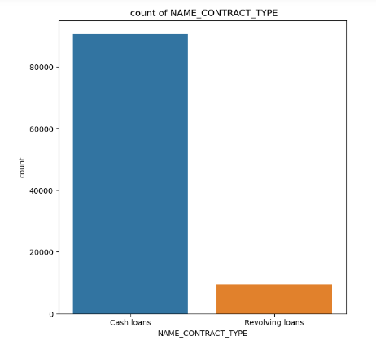
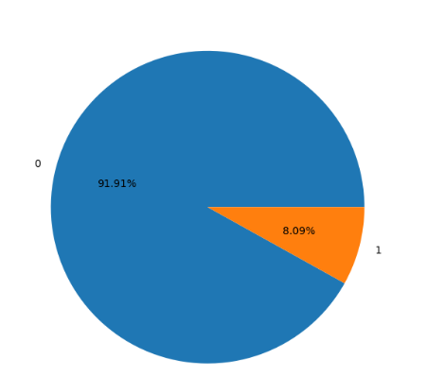
Univariate Analysis
Distribution of Contract_Type
Distribution of Target
Percentage of target
Interpretation:
By above graph we can conclude that there are more number of Cashloans.
Interpretation:
By above graph we can conclude that 8.09% clients are having payment difficulty.

Slide 6
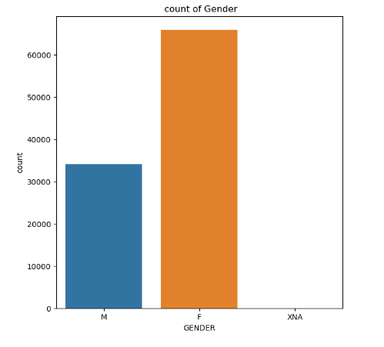
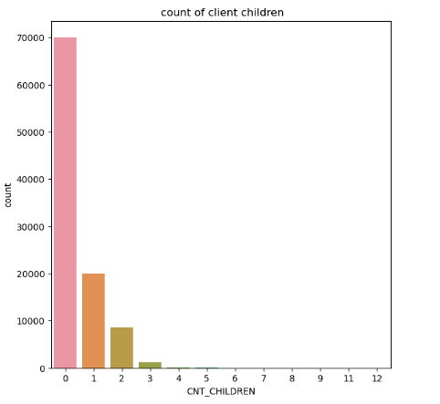
Distribution of Gender
Distribution of client children
Interpretation:
By above graph we can conclude that the clients mostly are Female
Interpretation:
By above graph we can conclude that most of the clients have no children.

Slide 7
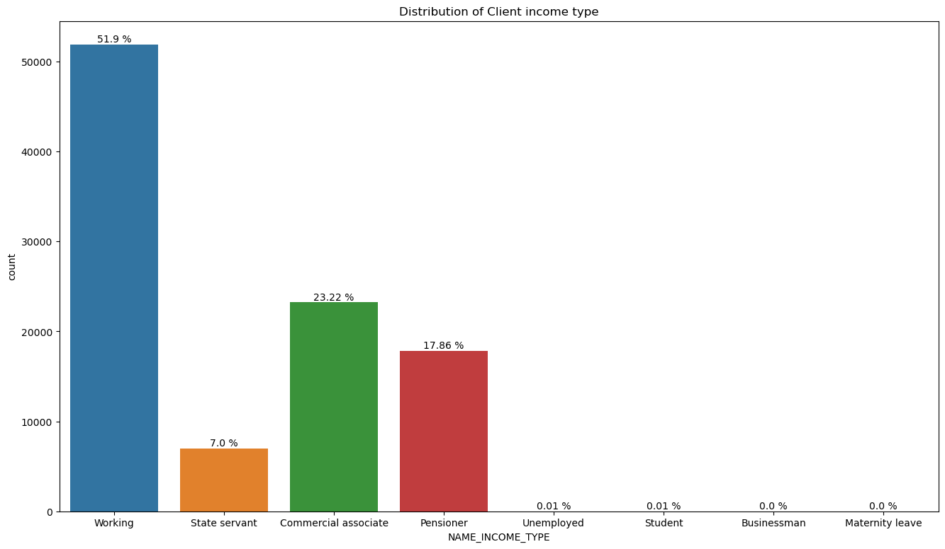
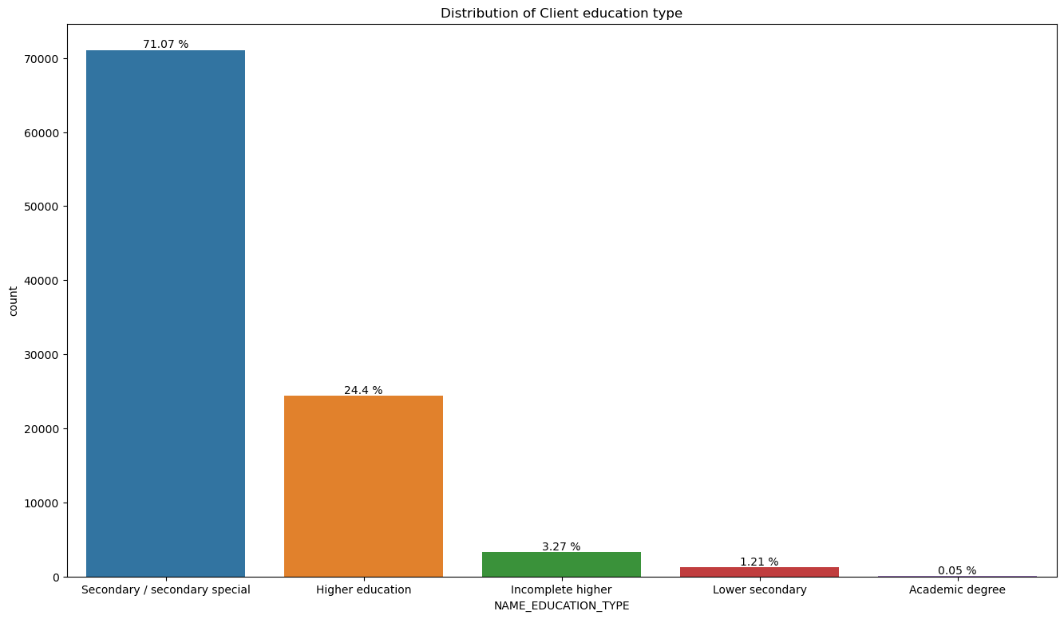
Distribution of Client income type
Distribution of Contract education type
Interpretation:
By observing above graph we can say that most of the clients have income type as working.
Interpretation:
By observing above graph we can say that most of the clients have education type as secondary/secondary education.

Slide 8
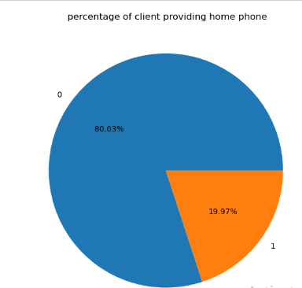
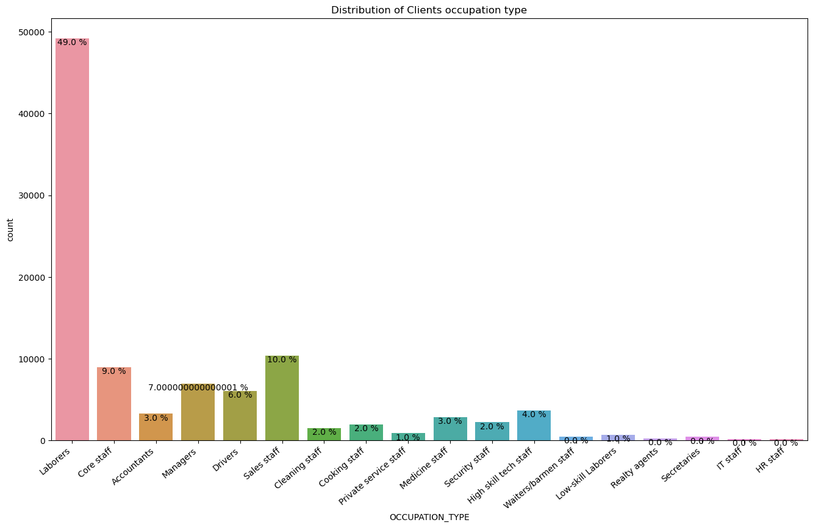
Distribution of Contract home phone
Distribution of Contract occupation type
Interpretation:
By observing above graph we can conclude that most of the clients have not provided their home phone.
Interpretation:
By observing above graph we can conclude that most of the clients have their occupation type as Laborers.

Slide 9
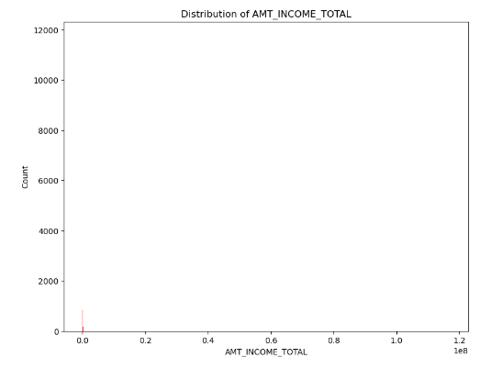
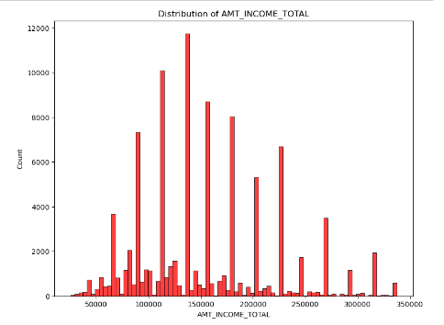
Univariate analysis
Distribution of Amount income type
Interpretation:
There are outliers in data so we need to perform outlier analysis.
By observing above graph we can conclude that most of the clients have income ranging between 100000 to 150000

Slide 10
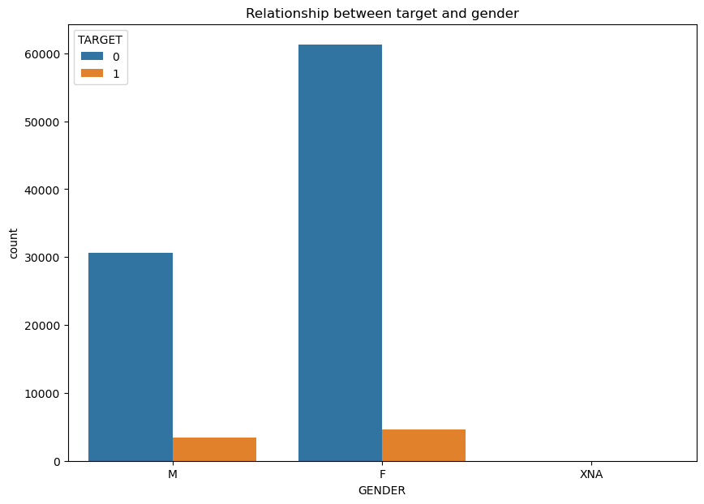
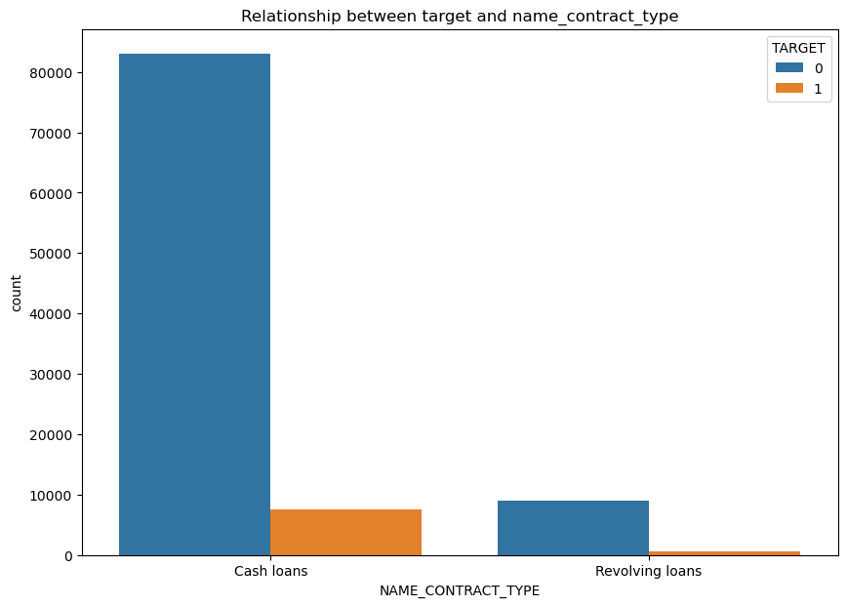
Bivariate Analysis
Relationship between target and NAME_CONTRACT_TYPE
Relationship between Target and gender
Interpretation:
Interpretation:
By above graph we can conclude that in category cash loans there are more number of clients that have difficulty in payment.
By above graph we can conclude that female category have more number of clients that have difficulty in payment.

Slide 11
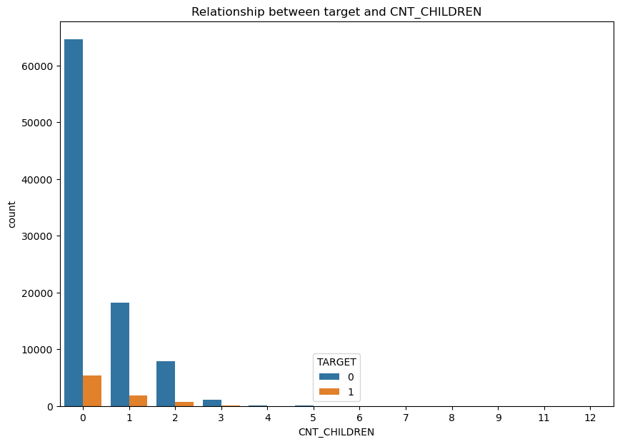
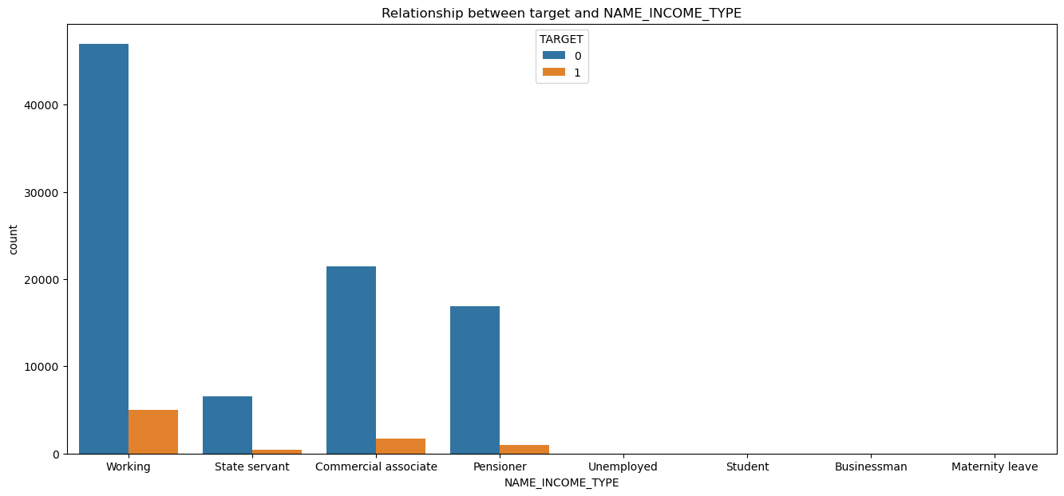
Relationship between Target and CNT_CHILDREN
Relationship between target and NAME_INCOME_TYPE
Interpretation:
By above graph we can conclude that clients that donot have children are more likely to be the clients that have difficulty in payment.
Interpretation:
By observing above graph we can say that clients who have their income type as working are more likely to have difficulty in payment.

Slide 12
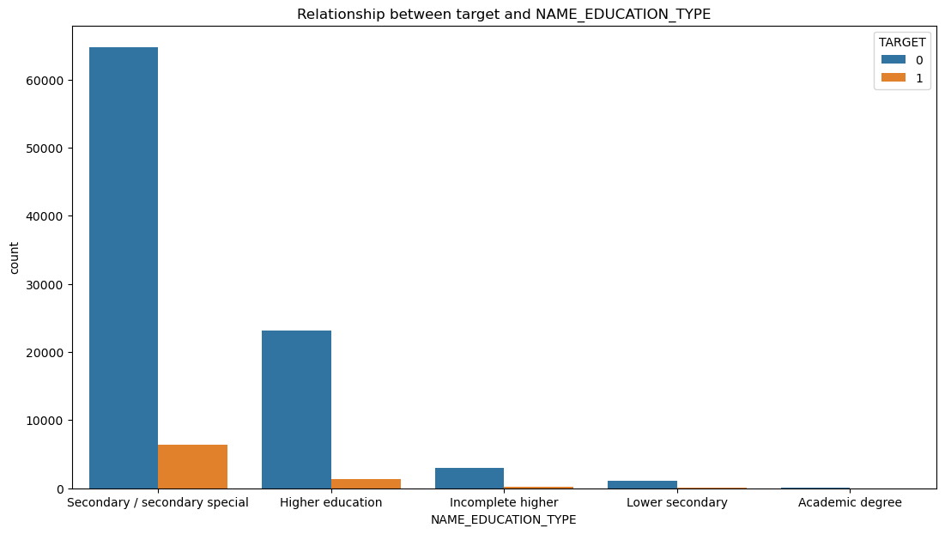
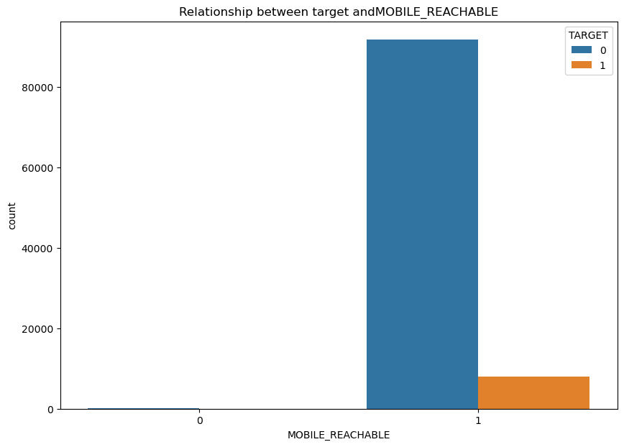
Relationship between target and NAME_EDUCATION_TYPE
Relationship between target and MOBILE_REACHABLE
Interpretation:
By above graph we can conclude that secondary/secondary special education types have more number of people with payment difficulties.
Interpretation:
By above graph we can conclude that most of the client who have difficulty in payment have their mobile reachable.

Slide 13
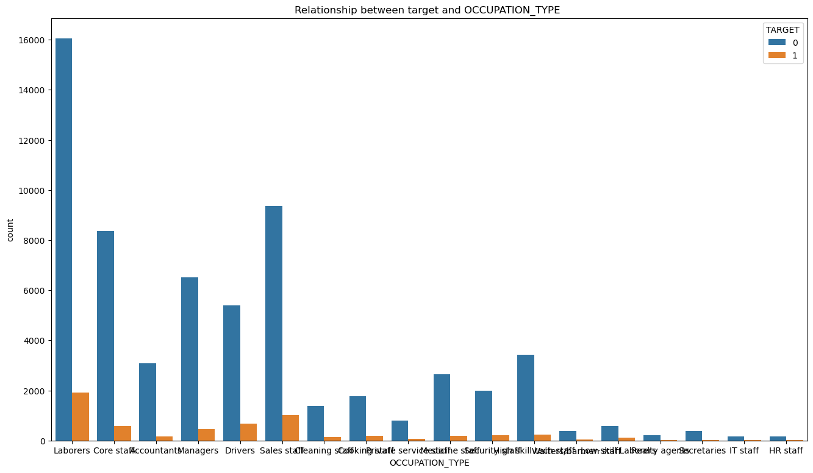
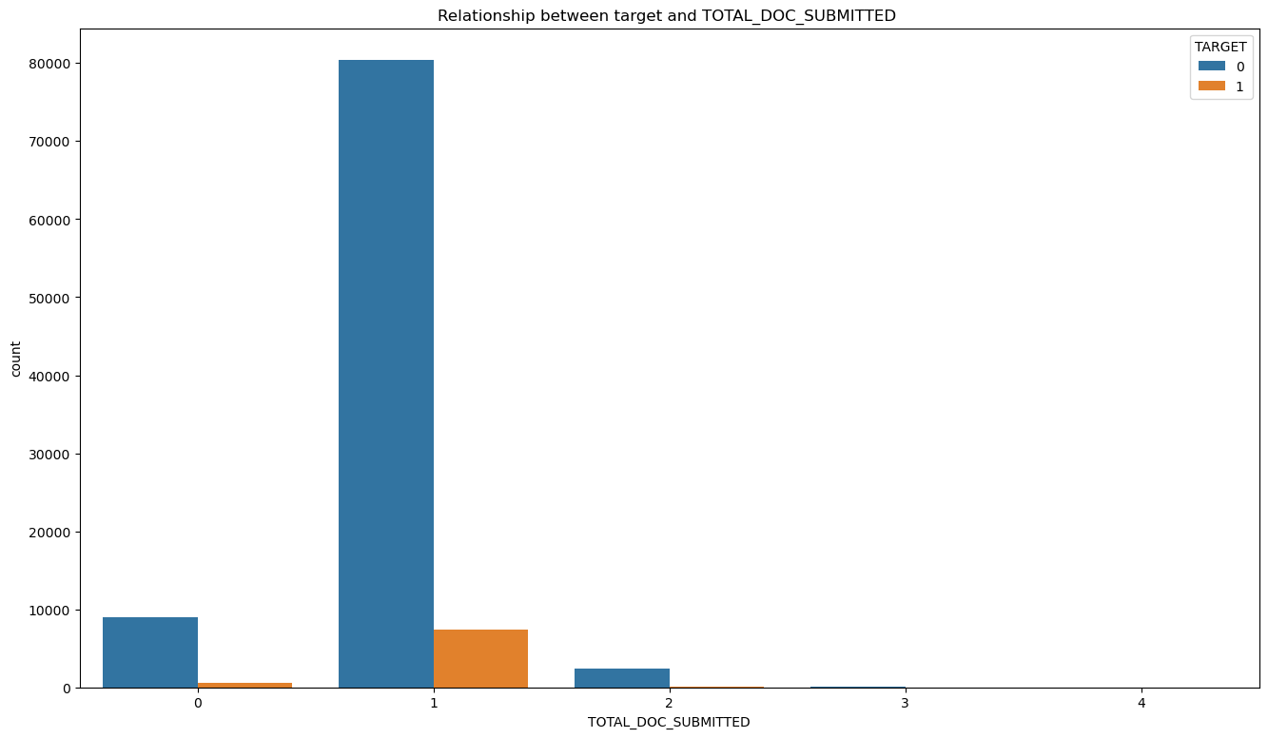
Relationship between target and OCCUPATION_TYPE column
Relationship between target and TOTAL_DOC_SUBMITTED
Interpretation:
Interpretation:
By observing above graph we can conclude that clients who have submitted 1 document have difficulty in payment.
By above graph we can conclude that clients whose occupation type is Laborers have difficulty in payment.

Slide 14
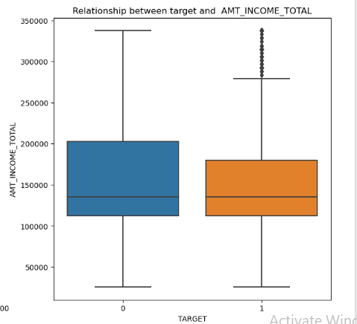
Relationship between target and AMT_INCOME_TOTAL
Interpretation:
By above graph we can conclude that client having income ranging between 100000 to 200000 has payment difficulty.

Slide 15
Conclusion
By the analysis we can conclude that the female clients with cash loans, those who have 1 children, Income type as Working, education type as Secondary/secondary special , occupation type as laborers, document submitted is only one and their amount income ranging between 100000 to 200000 are more likely to become defaulters.
By considering these factors and carefully evaluating them the firm can identify customers that have lower probability of becoming a defaulter and can make decisions during loan approval process.

Slide 16
ThankYou

